Slide 1
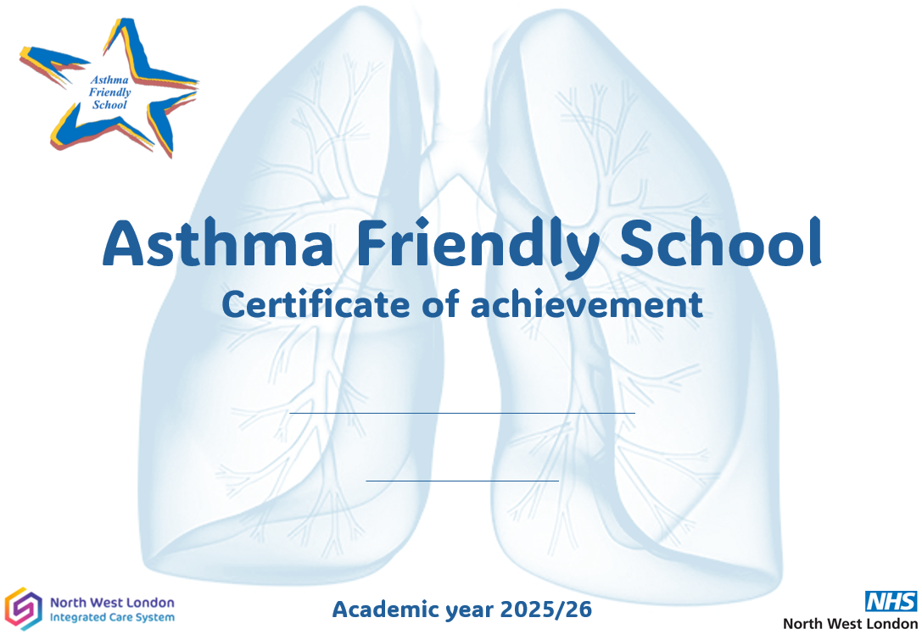
The Jubilee Academy
11.3.26

