Slide 1
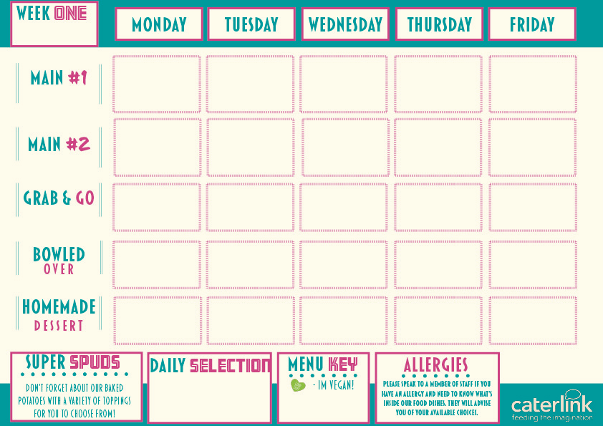




Chicken Enchilada with Rice
Roast Turkey, Roast Potatoes, Seasonal Vegetables & Gravy
Chip Shop Fish or Chicken Sausage with Chips, Mushy Peas and Gravy/ Curry Sauce
Crunchy Crouton
Mac & Cheese
Jerk Chicken with Rice and Peas and Pineapple Slaw
Roasted Vegetable
Filo Pastry Tart Roast Potatoes & Seasonal Vegetables
Curried Squash, Sweet Potato & Butterbean Stew with Rice and Peas & Pineapple Slaw
Chip Shop Vegan Sausage with Chips, Mushy Peas and Gravy/ Curry Sauce
Bang Bang Cauliflower Mac & Cheese
Quorn Chilli Loaded Wedges
Pineapple Upside
Down Cake
Chocolate Crunch Cake
Summer Fruit Crumble with Custard
Warmed Jamaican Ginger Cake with Ice Cream or Custard
Iced Sponge Cake

Slide 2
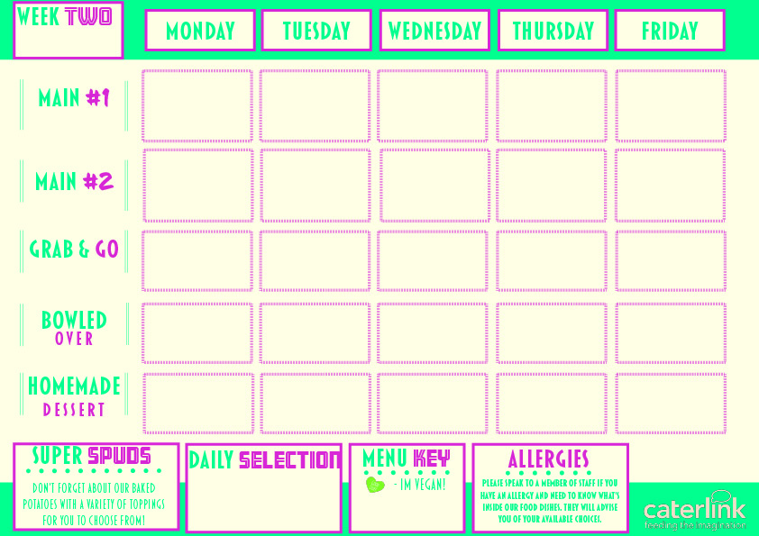


Chicken Sausage and Red Onion Chutney Hot Baguette with Roasted Potatoes
Vegetable Chow Mein
Chicken Souvlaki with Greek Salads
Chicken Tikka Masala with Rice
Breaded Fish, Chips & Garden Peas
Sweet and Sour Vegetables with Rice
Vegan Sausage and Red Onion Chutney Hot Baguette with Roasted Potatoes
Cheese and Leek Frittata with Chips and Garden Peas
Feta, Honey and Spinach Parcel with Greek Salads
Sweet Potato, Chickpea & Spinach Curry with Rice
Chocolate Sponge Pudding
Custard Tart with Mixed Berry Compote
Sticky Toffee Apple Crumble and Custard
Jam and Coconut Sponge
Oaty Flapjack

Slide 3
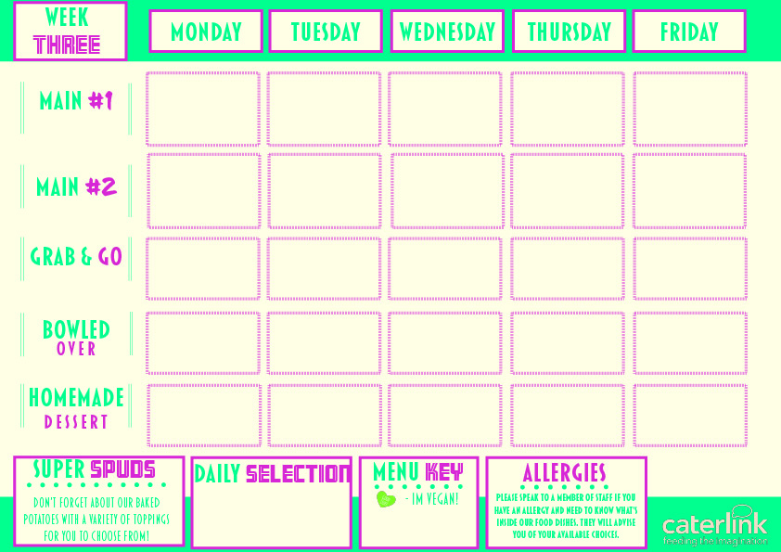


Chicken Sausage & Mashed Potato with Fresh Vegetables
lamb Lasagne with Garlic Bread
and Salad
Spicy Mexican Chicken with Rice and Sides
Chicken Paella with Patatas Bravas and Salads
Fish and Chips with Garden Peas or Baked Beans
Vegetarian Toad in the Hole with Mashed Potatoes & Gravy
Vegan Chilli with Rice and Sides
Vegetable Ragu with Garlic Bread and Spaghetti
Spanish Tortilla with Patatas Bravas and Salads
Vegetarian Burger and Chips with Garden Peas or Baked Beans
Chocolate Orange Cookie
Apple Pie
with Cream
Fruit Muffins
Peach Cake
Chocolate Brownie

